Slide 1
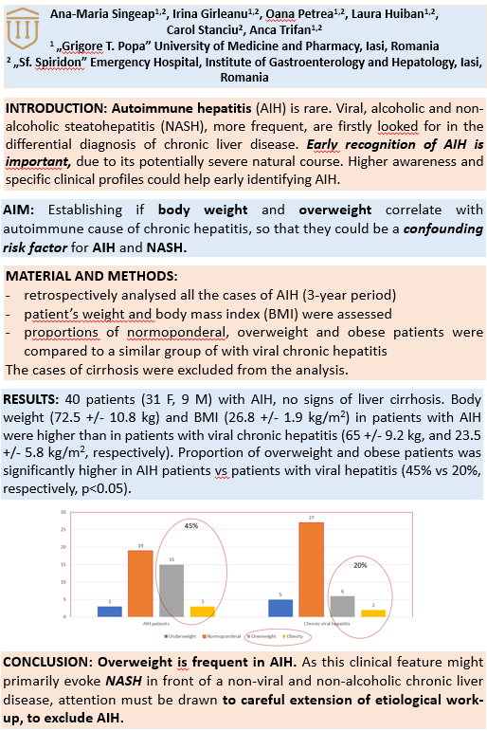
BODY MASS INDEX – A NOTICEABLE FEATURE IN THE CLINICAL PROFILE
OF AUTOIMMUNE HEPATITIS

