Slide 1
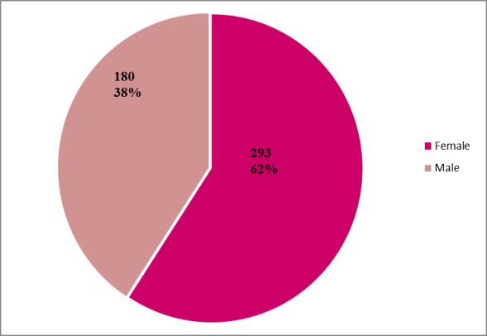
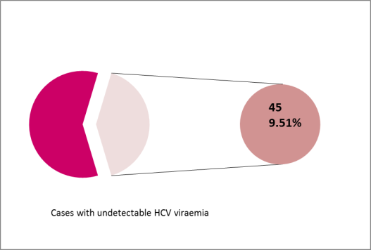
SPONTANEOUS SEROREVERSION OF ANTI-HEPATITIS C VIRUS DURING THE NATURAL COURSE OF HEPATITIS C VIRUS INFECTION IN THE PATIENTS EVALUATED FOR TREATMENT - A SINGLE CENTER EXPERIENCE
Camelia Cojocariu^{1,2}, Laura Huiban^{1,2}, Carol Stanciu², Cristina-Maria Muzica^{1,2}, Oana Stoica^{1,2}, Irina Girleanu^{1,2}, Ana-Maria Singeap^{1,2}, Tudor Cuciureanu^{1,2}, Stefan Chiriac^{1,2}, Anca Trifan^{1,2}
1 “Grigore T. Popa “ University of Medicine and Pharmacy
2 Institute of Gastroenterology and Hepatology, Iasi, Romania
INTRODUCTION: Hepatitis C virus (HCV) infection is common worldwide but there are different prevalence rates in different countries. Spontaneous viral clearance occurs in 10–25% of infected individuals after acute infection yet controversy exists regarding the frequency of spontaneous clearance during the natural course of HCV infection in the general population.
AIM: In our study we aimed to evaluate undetectable ARN HCV prevalence in antibodies HCV population evaluated for IFN free treatment.
MATERIAL AND METHODS: We performed a prospective study in which we included all patients with positive anti -HCV antibodies who were admitted in a tertiary referral center from North-Eastern Romania and were evaluated for IFN free treatment between June 1st 2018 and March 1st 2019. All patients included in the study performed the quantitative determination of HCV viraemia. The patients with sustained virological response to interferon (IFN) therapy were excluded from the study.
RESULTS: The study included 473 persons with positive anti -HCV antibodies; mean age was 54.6±5.2 years, predominantly female (293- 61.94%). Among all patients with positive anti-HCV antibodies, in 45 (9.51%) cases we found undetectable HCV viraemia. Seroreversion occurred in individuals with a median age of 58 years (range 45–66). Of the patients with undetectable HCV viraemia, 28.8% had elevated transaminases.
473
CONCLUSIONS: The frequency of spontaneous viral clearance in a homogeneous population of immunocompetent subjects not related to treatment with IFN was low (9.51%). These data are consistent with the literature where viral spontaneous clearance was 2-10% in a cohort of HCV infection.

