Slide 1
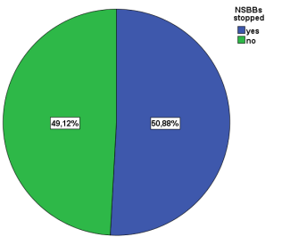
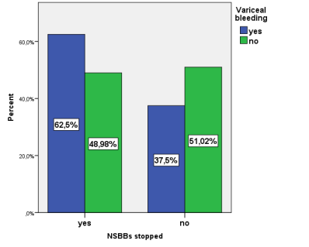
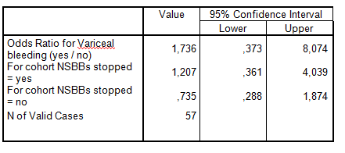
E-POSTER Nr 5
THE RISK OF VARICEAL BLEEDING AFTER STOPPING BETA BLOCKERS IN CIRRHOTIC PATIENTS WITH REFRACTORY ASCITES
Irina Girleanu, Anca Trifan, Andreea Teodorescu, Camelia Cojocariu, Oana Cristina Petrea, Ana Maria Singeap, Catalin Sfarti, Stefan Chiriac, Laura Huiban, Nemteanu Roxana, Tudor Cuciureanu, Carol Stanciu
“Grigore T. Popa” University of Medicine and Pharmacy, “St. Spiridon” University Hospital, Institute of Gastroenterology and Hepatology, Iași, Romania
Introduction
The non selective beta-blockant (NSBB) treatment in cirrhotic patients has several limitations regarding side effects, as arterial hypotension or bradicardia. Caution should be taken in cirrhotic patients with refractory ascites, hyponatremia or arterial hypotension, as NSBB could precipitated the development of the acute kidney injury.
The aim of this study was to evaluate the risk of variceal bleeding after the NSBB treatment is stopped in patients with refractory ascites.
Material and Methods
All consecutive patients with liver cirrhosis and refractory ascites admitted to the Institute of Gastroenterology and Hepatology from January 2017 to December 2017 were included in this study. The diagnosis of refractory ascites was established according to the current guidelines.
Results
Results
During the study period a total of 57 patients were diagnosed with refractory ascites. In more than half of them, 29 patients (50.8%), the NSBB treatment was stopped, the main cause of stopping the treatment being systolic blood pressure less than 90 mmHg.
The majority of the patients were receiving propranolol (86.2%), and only 4 patients (3.8%) received carvedilol.
Out of the 29 patients that stopped the treatment, 21 (72.4%) were Child-Pugh class C, and 5 patients (17.2%) developed variceal bleeding.
The risk of variceal bleeding was not increased in cirrhotic patients with refractory ascites that stopped the NSBB treatment ( OR 1.207, CI 0.361-4.039, p=0.796).
Conclusions
Stopping the NSBB treatment in patients with refractory ascites is not associated with an increased risk of variceal bleeding, despite the severity of liver disease.

Slide 2
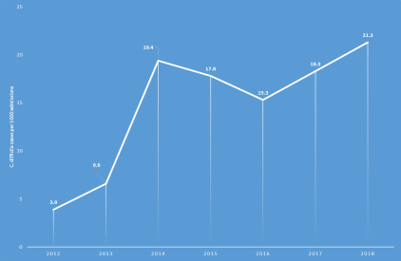
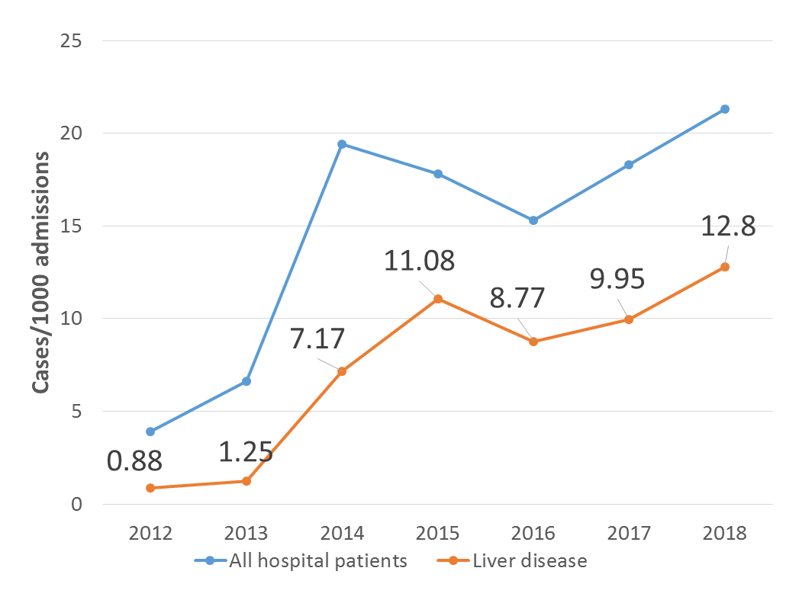
E-POSTER Nr 7
INCIDENCE OF CLOSTRIDIUM DIFFICILE INFECTION IN PATIENTS WITH LIVER CIRRHOSIS
Oana Cristina Petrea, Carol Stanciu, Irina Girleanu, Ana-Maria Singeap, Camelia Cojocariu, Laura Huiban, Cristina Muzica, Stefan Chiriac, Anca Trifan
“Grigore T. Popa” University of Medicine and Pharmacy, “St. Spiridon” University Hospital, Institute of Gastroenterology and Hepatology, Iași, Romania
Introduction
Clostridium difficile infection (CDI) remains the leading cause of healthcare- associated diarrhoea worldwide. Despite multiple efforts to prevent this infection, CDI has increased over past years both in incidence and severity. Traditionally, CDI was more frequently diagnosed in elderly patients with recent antibiotic exposure, prolonged hospitalizations, immunodeficiency or prior gastrointestinal surgery. Despite these traditional risk factors, CDI incidence became more constant in other several subpopulations of patients like those with liver cirrhosis.
The aim of this study was to assess the incidence of CDI in patients admitted at a tertiary referral center from Northeast Romania, focusing on patients diagnosed with liver cirrhosis.
Material and Methods
We performed a retrospective analysis of all cases of CDI admitted to our institute between January 2012 and December 2018. CDI was defined as the presence of toxin A or B (or both) in a diarrhoeal specimen stool, and classified as community-associated or healthcare-associated.
Results
Over the study period, there was a significant increase in the overall incidence rates of CDI, with almost 3.9 cases/1000 admissions in 2012 and 21.3 cases/1000 admissions in 2018. The same ascending trend was observed in patients with liver cirrhosis. The overall incidence rate in this category of patients was 0.88 cases/1000 admissions in 2012 with an increase of 12.8 cases/1000 admissions in 2018.
Conclusions
CDI incidence is increasing over time with liver cirrhosis being one of the most susceptible risk category. Thus, understanding time trends in CDI incidence rates along with risk categories is important to improve CDI surveillance and prevention methods with a much better management and outcome of CDI in healthcare facilities.

Slide 3
OPTIMISING THE TREATMENT OF ACUTE HEPATIC ENCEPHALOPATHY IN PATIENTS WITH LIVER CIRRHOSIS
Diana Sahawneh¹, Alexandra Leahu¹, Maria Asaftei¹, Irina Girleanu^{1,2}, Oana Petrea^{1,2}, Carol Stanciu¹, Anca Trifan^{1,2}, Camelia Cojocariu ^{1,2}
Institute of Gastroenterology and Hepatology, “St. Spiridon” Emergency Clinical Hospital¹, “Grigore T. Popa” University of Medicine and Pharmacy², Iasi, Romania
INTRODUCTION
Hepatic encephalopathy (HE) is a potentially reversible functional disorder of the brain with neurological and psychiatric symptoms. HE occurs in more than 70% of patients with advanced liver disease and the most frequent precipitating factors are gastrointestinal bleeding, infections, medications, etc. An important aim of treatment of HE is the reduction of the ammonia level by lowering the amount of ammonia produced and increasing its detoxification. Enteric production of ammonia can be decreased by non-absorbable disaccharides such as lactulose and antibiotics such as rifaximin. L-ornithine -L-aspartate (LOLA), the salt of the natural amino acids ornithine and aspartate acts through the mechanism of substrate activation to detoxify ammonia.
AIM: To determine the efficacy of LOLA in addition to therapy with lactulose and rifaximin for the treatment of HE.
METHODS
We have examined 66 patients with liver cirrhosis (LC) admitted in St. Spiridon Emergency Hospital Iasi for HE during 2018. Subjects were divided into two equal groups (n = 33) with similar age, gender and characteristics of liver disease (ethiology, Child-Pugh score). Group 1 received lactulose and rifaximin and Group 2 lactulose, rifaximin and LOLA.
RESULTS
Among our study group, of which stage B by Child-Pugh in 9 (13.63%); stage C in 57 (86.36%), all patients had chronic liver cirrhosis and hepatic encephalopathy (HE) I–III degrees according to West Haven criteria.
All patients were divided into two groups (n=33) depending on the therapeutic approach: I - lactulose 20 ml x2/day + rifaximin 1200 mg/day; II – LOLA 15 g/day + lactulose 20 mlx2/day + rifaximin 1200 mg/day. There were no significant differences regarding age, sex and cirrhosis etiology between the two groups. The patients that received LOLA had a lower readmission rate in compare with those without LOLA treatment (33.36% vs 54.54%, p=0,002). The mortality rate was similar in both groups. After 10 days of treatment, the ammonia concentration in the blood on the therapy background decreases maximum in patients of group II – 59.3% versus 30.5% in group I (p=0,01).
CONCLUSION
In clinical trials, LOLA has shown a statistically significant effect to reduce HE grade, in reduction of blood ammonia concentration and positive effects on psychomotor function in patients of cirrhosis with minimal HE and overt chronic Grade I HE, as compared to placebo.
However, there is lack of data on the efficacy of LOLA in patients with overt acute hepatic encephalopathy which is one of the major causes of hospital admissions and resource utilization in decompensated cirrhosis. The combined therapy of HE with Rifaximin, LOLA and basic therapy proved to be the most effective.
Parameters | Total number n=66 | Group I (n=33) | Group II (n=33)
Medium age | 59.2±15.7 | 56.8±11.2 | 61.1±4.4
sex f:m | 28:38 32.4%:67.6% | 15:18 27.6%:72.4% | 13:20 37.8%:62.2%
Cirrhosis etiology (alcohol vs. C vs. B) | 37 vs. 18 vs.11 | 18 vs. 8 vs.7 | 19 vs. 10 vs. 4
Child B vs. Child C | 9 (13.63%)/ 57 (86.36%) | 4/29 | 5/ 28

Slide 4
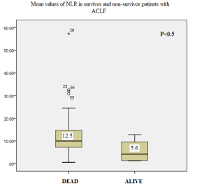
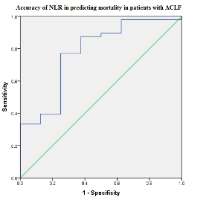
The role of neutrophil-to-lymphocyte ratio in the prediction of outcome of patients with decompensated cirrhosis with and without acute-on-chronic liver failure
Chiriac, Stefan^{1,2}; Stanciu, Carol²; Cojocariu, Camelia^{1,2}; Sfarti, Catalin^{1,2}; Singeap, Ana Maria^{1,2}; Girleanu, Irina^{1,2}; Cuciureanu, Tudor^{1,2}; Stoica, Oana^{1,2}; Huiban, Laura¹; Muzica, Cristina Maria¹; Trifan, Anca^{1,2}
Affiliations:
"Grigore T. Popa" University of Medicine and Pharmacy Iasi, Iasi, Romania.
Institute of Gastroenterology and Hepatology, "St. Spiridon" University Hospital, Iasi, Romania.
Background:
Patients with decompensated liver cirrhosis hospitalized in the intensive care unit present a high mortality rate.
When acute-on-chronic liver failure (ACLF) is associated, the death rate is even higher. A simple method of assessing prognosis in cirrhotics is currently under evaluation, namely neutrophil-to-lymphocyte ratio (NLR).
Aim: to assess the accuracy of NLR in predicting outcome in decompensated cirrhotic patients with and without ACLF
Methodology:
retrospective analysis of patients diagnosed with liver cirrhosis hospitalized for acute decompensation between January 2017-June 2017 in The Intensive Care Unit of a North-eastern Romanian tertiary care center.
Exclusion criteria: concurrent malignancy, immunosuppressive treatment, pregnancy or immunodeficiency virus infection;
Laboratory tests from venous blood obtained within 12 hours of admission were retrieved.
The studied outcome was 28-day mortality
Results:
Variable | ACLF 58 pts (82.85%) | No ACLF 12 pts (17.14%) | P
Age (years) | 61.5 ± 3 | 62.1 ± 4 | 0.758
Ascites, n, % | 42 (72.4) | 2 (20) | 0.03
SBP, n, % | 12 (20.7) | 0 | 0.189
Infections, n, % | 36 (62.1) | 3 (25) | 0.019
NLR | 11.53 ± 9.7 | 13.04 ± 8.53 | 0.662
MELD score | 26.5 ± 8.38 | 14.75 ± 3.77 | 0.008
Child Score | 11.03 ± 2.3 | 7.75 ± 0.95 | 0.007
Death rate, n, % | 49 (84.5) | 4 (33.3) | 0.001
ROC analysis in patients without ACLF, AUC = 0.611.
when patients with ACLF were considered AUC = 0.776.
Conclusion: NLR has shown potential in predicting short-term mortality in patients with decompensated liver cirrhosis and ACLF. However, it should be noted that for patients without ACLF NLR does not present adequate accuracy and therefore caution is required in selecting the patients that could benefit from this predictive method

Slide 5
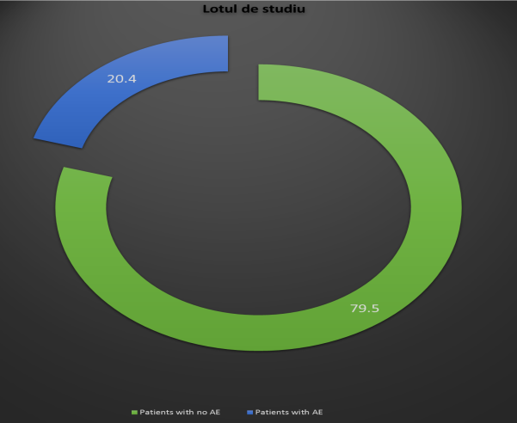
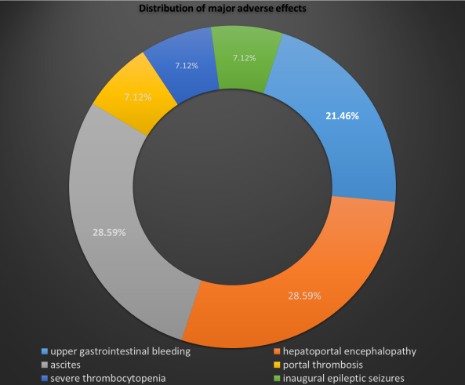
FUNCTIONAL LIVER RESERVE - A PREDICTIVE FACTOR FOR THE ADVERSE EFFECTS OF ANTIVIRAL TREATMENT IN PATIENTS WITH HEPATITIS C VIRUS DECOMPENSATED LIVER CIRRHOSIS - A SINGLE CENTER EXPERIENCE
Laura Huiban^{1,2}, Carol Stanciu², Cristina-Maria Muzica^{1,2}, Oana Cristina Stoica^{1,2}, Ana Maria Sîngeap^{1,2} Irina Gîrleanu^{1,2}, Ştefan Chiriac^{1,2} , Ioana Roxana Galatanu², Sebastian Zenovia², Tudor Cuciureanu^{1,2}, Anca Trifan^{1,2}
1 “Grigore T. Popa “ University of Medicine and Pharmacy
2 Institute of Gastroenterology and Hepatology, Iasi, Romania
INTRODUCTION. The advent of the new therapeutic strategies with direct antiviral agents in patients with hepatitis C virus liver cirrhosis (HCV- LC) required the need for correlation with clinical practice data on possible adverse effects (AE). We aimed to evaluate AE during and after antiviral treatment with Ledipasvir/Sofosbuvir ± Ribavirin (LED / SOF ± RBV) in patients with decompensated HCV-LC and their correlation with baseline liver functional status.
MATERIAL AND METHODS.
a retrospective study in a tertiary center in northeastern Romania
between May 2017 and February 2019
included patients with decompensated HCV-LC treated with LED / SOF ± RBV.
The frequency of AE and correlation with baseline liver functional status, as estimated by the MELD and Child-Pugh score (CPS), were assessed.
RESULTS. The study included 88 patients (52 women - 59.1%, 36 men - 40.9%), with an average of 56 ± 0.28 years. Overall, 27 (30%) of AE were recorded in 18 patients, of which 10 (56%) had major AE and 8 (44%) patients with minor AE. There were 14 (52%) types of major AE (3 (21.4%) cases of upper gastrointestinal bleeding due to acute esophageal variceal bleeding, 4 (28.5%) clinically significant hepatoportal encephalopathy, 4 (28.5%) with refractory ascites, 1 (7.1%) with portal thrombosis, 1 (7.1%) with severe thrombocytopenia, 1 (7.1%) inaugural epileptic seizures) and 13 (48%) of minor AE (4 (30.76%) with insomnia, 7 (53.84%) with marked physical asthenia and 2 (15.38%) cases involving nausea and vomiting). In the group of 82 patients with CPS class B, AE were recorded in 15 (18.3%) compared with 3 (50%) patients with AE in 6 patients with CPS class C. Those with CPS class C presented a higher risk for the development of significant AE [OR = 7.7, 95% CI (1.79-33.1), P = 0.19]. There were 68 patients with MELD <15 and 20 with MELD> 15. AE in patients with MELD <15 were found in a proportion of 19.1% compared to 25% in patients with MELD ≥15. The comparative analysis showed significant differences between patients, those with CPS class C and MELD ≥ 15 had a higher risk of AE.
CONCLUSIONS. Pre-existing liver dysfunction predisposes to significant AE, justifying a rational and prudent recommendation for antiviral treatment in patients with advanced decompensated LC.

Slide 6
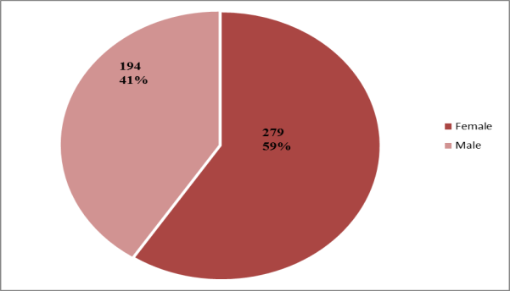
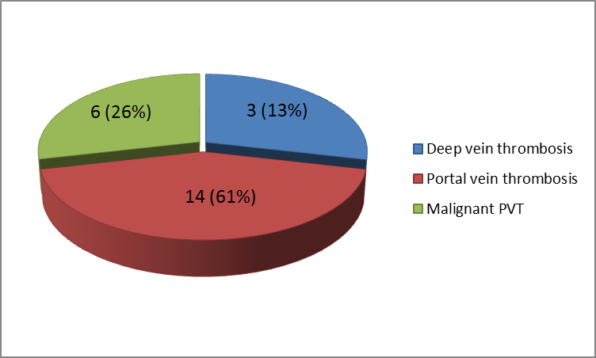
THROMBOTIC EVENTS IN PATIENTS WITH HEPATITIS C VIRUS LIVER CIRRHOSIS TREATED WITH DIRECT ACTING ANTIVIRALS AND SUSTAINED VIROLOGICAL RESPONSE- A REAL LIFE STUDY
Laura Huiban^{1,2}, Carol Stanciu², Cristina-Maria Muzica^{1,2}, Oana Cristina Stoica^{1,2}, Ana Maria Sîngeap^{1,2} Irina Gîrleanu^{1,2}, Ştefan Chiriac^{1,2} , Ioana Roxana Galatanu², Sebastian Zenovia², Tudor Cuciureanu^{1,2}, Anca Trifan^{1,2}
1 “Grigore T. Popa “ University of Medicine and Pharmacy
2 Institute of Gastroenterology and Hepatology, Iasi, Romania
INTRODUCTION: The advent of direct-acting antivirals (DAAs) is a major breakthrough in hepatology representing the therapeutical standard of care in patients with chronic hepatitis C virus infection over the past few years. Despite high rates of sustained virological response (SVR), DAAs therapy doesn’t eliminate the risk of thrombotic events.
AIM: In our study we aimed to assess the occurrence of thrombotic events and clinical presentation in patients treated with DAAs and sustained virological response.
MATERIAL AND METHODS:
retrospectively analyzed a cohort of patients with HCV-related liver cirrhosis treated with PrOD ± RBV and LED/SOF ± RBV for 12/24 weeks,
in a tertiary gastroenterology center from North-Eastern Romania,
between January 1st 2016 and July 1st 2018.
all patients with presumption of thrombosis were evaluated by vascular Doppler, abdominal ultrasound and confirmed by CT scan.
RESULTS: The study included 473 HCV-infected cirrhotic patients treated with PrOD or LED/SOF, with documented SVR, mean age 69,7 ± 5,5 years, predominantly female (59%). Of the total number, 284 (60.04%) received PrOD and 189 (39.95%) patients were treated with LED/SOF. Thrombotic complications were reported in 23 (4.86%) patients: 3 (13.04%) with deep vein thrombosis, 14 (60.86%) with portal vein thrombosis (PVT), 6 (26.08%) with malignant PVT. All patients had associated cardiovascular (15-65.21%) and metabolic comorbidities (8-34.78%). The main clinical manifestations at diagnosis were: swelling, edema, erythema and lower limb pain in 3 patients, upper digestive haemorrhage in 8 patients, ascitic decompensation in 4 patient, abdominal pain in 5 patients and 3 patients were asymptomatic. Biologically there was no significant change in prothrombin serum levels (baseline values in patients treated with PrOD was 11.67 ± 0.91 versus 11.70 ± 0.83 at SVR, p=0.993, respectively 11.5 ± 0.84 sec at baseline versus 11.4 ± 0.68 at SVR, p=0.715 in patients treated with LED/SOF±RBV) and platelet count (126 000 (101 500-162 000) vs. 131 000 (101 000-165 000), p= 0.818 in patients treated with PrOD, respectively 94857.14 ± 32 vs. 92428.57 ± 35, p= 0.853, in patients treated with LED/SOF+RBV).
CONCLUSIONS: We conclude that thrombotic events in patients with HCV-related liver cirrhosis treated with DAAs are not influenced by the variations of coagulation parameters, rather correspond to the hypercoagulability status and the natural evolution of the cirrhotic patient.

