Slide 1
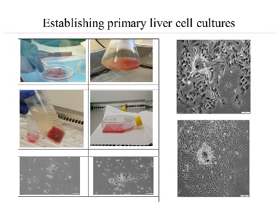
Phenotypic assessment of liver-derived cell cultures during in-vitro cell population expansion protocol
Razvan Iacob, Vlad Herlea, Ioan Valentin Matei, Ioana Raluca Florea, Veronica Madalina Ilie, Irit Meivar-Levy, Daniela Lixandru, Simona Olimpia Dima, Radu Albulescu, Cristiana Tanase, Irinel Popescu and Sarah Ferber

